Slide 1
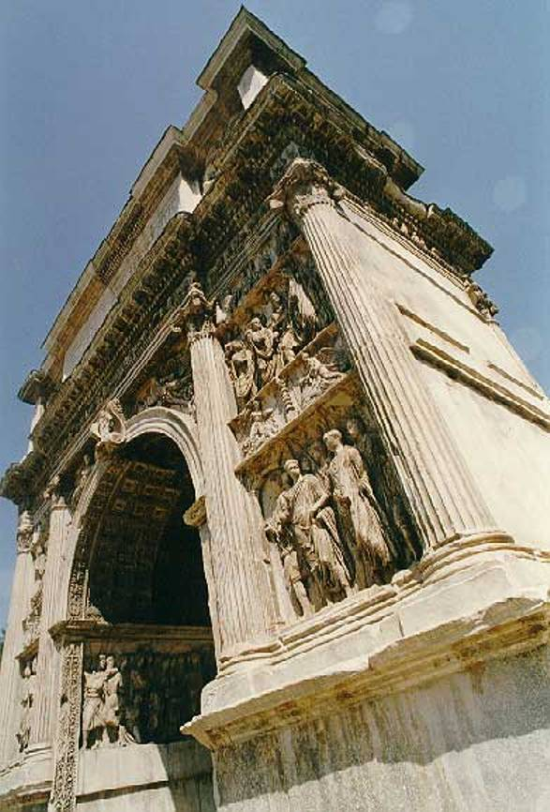
Roberto Tersigni
Massimo Capaldi
Pancreatic leakage after pancreaticoduodenectomy for cancer
Benevento, 22 giugno 2012

Slide 2
PANCREATICODUODENECTOMY FOR CANCER
Pancreaticoduodenectomy is the treatment of choice for patients with resectable carcinoma of the pancreatic head and periampullary region
Morbidity is still around 20% to 50%
Mortality is < 5 % in high volume centers
Mortality is 12,5% in Italy

Slide 3
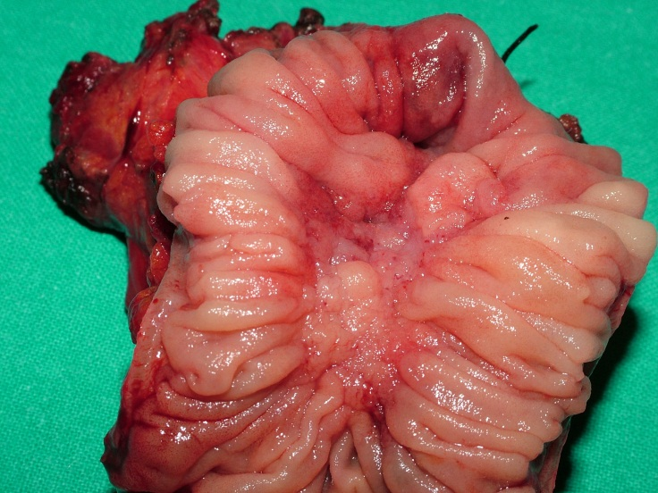
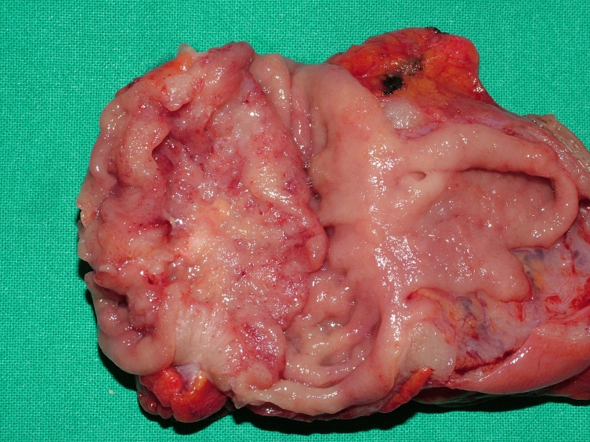
Pancreas
Duodenum

Slide 4
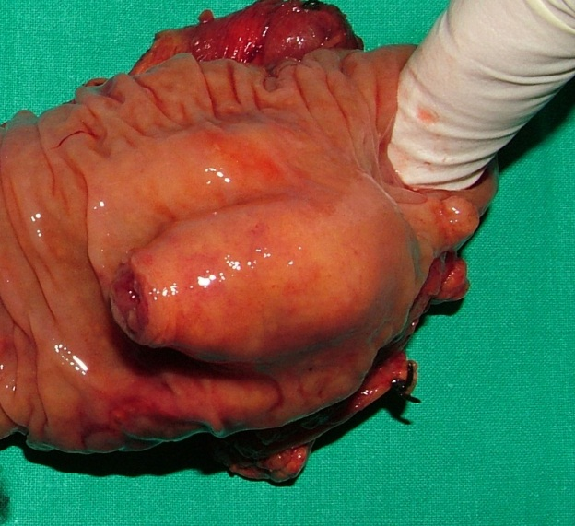
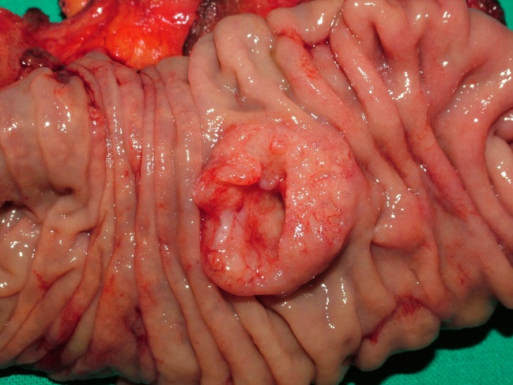
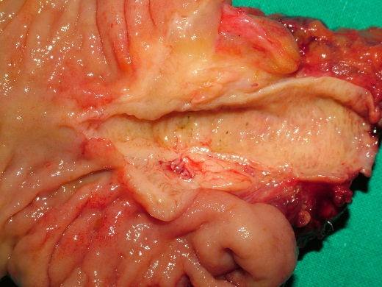
Intrapancreatic Biliary Duct
Ampulla of Vater

Slide 5
Radical Limphadenectomy

Slide 6
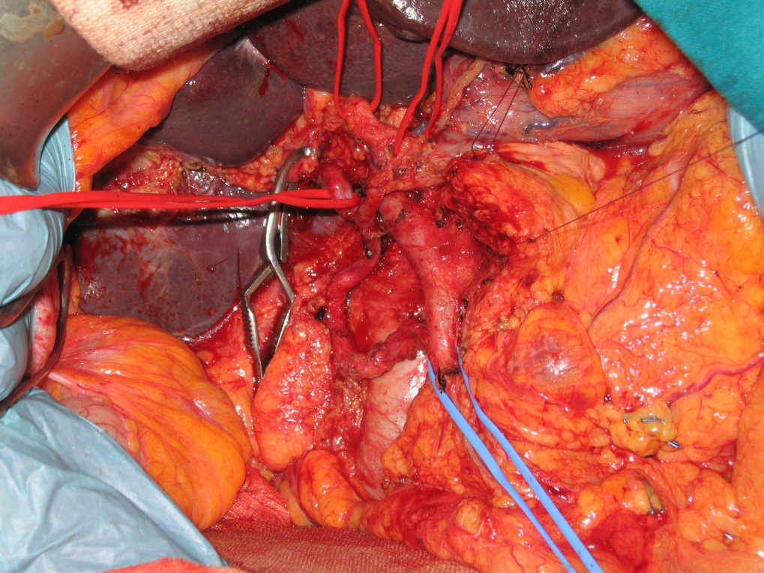
Anomalous Vessels

Slide 7
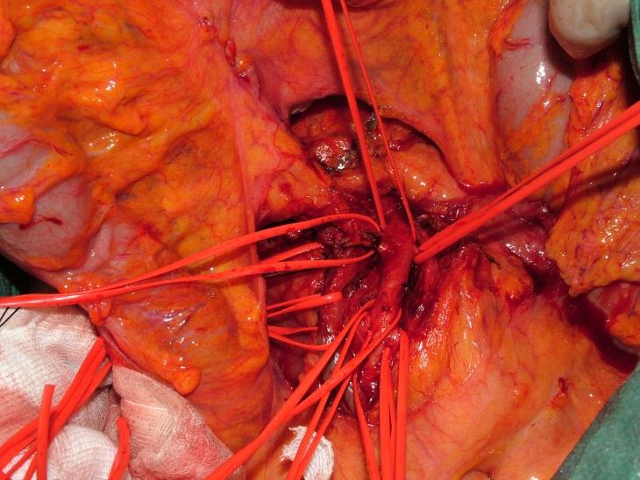
Arterial and Venous involvement

Slide 8
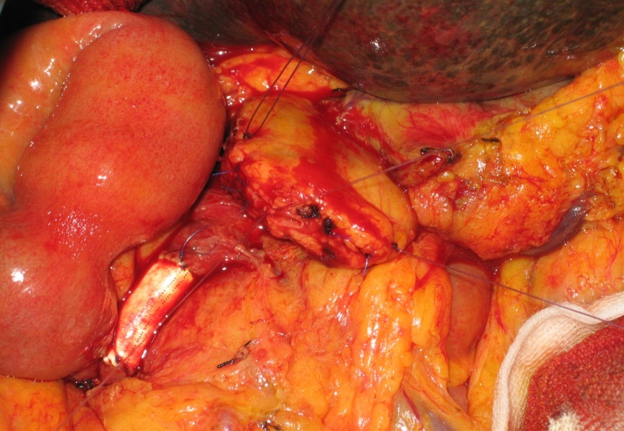
Venous infiltration > 180 °
Venous infiltration < 180°

Slide 9
Secondary Pancreatic Head Cancer

Slide 10
IntraOperativeRadioTherapy

Slide 11
Abdominal complications after duodenopancreatic resection
TYPE OF COMPLICATION
CLINICAL DEFINITION
Pancreatic Fistula
Abdominal collection
Haemorrhage
Delayed gastric empting
Acute pancreatitis
Output rich in amylase, stadiation by ISGPF
Collection of fluid measuring at least 5 cm in diameter
Requirement of > 3 Units of pRBC/ 1000 ml
Nasogastric tube decompression for >10days
At least a 3 fold increase of normal plasma amylase or lipase 48h after the operation

Slide 12
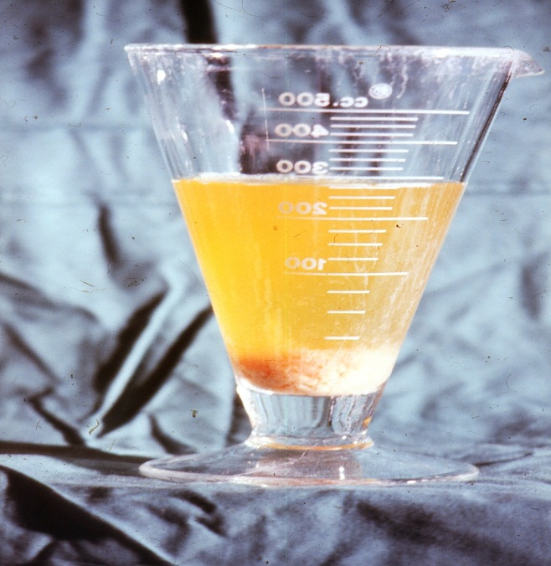
PANCREATIC FISTULA
Pancreatic leakage is the most important complication from which 40% of patients death are the result of septic or haemorrhagic complications
The incidence of Pancreatic Fistula varies from 10% to 25% without reduction in the past decade
Whipple reported 19,5% Fistula rate more than 50 years ago

Slide 13
Origin and Definition of Pancreatic Anastomotic Fistula
ORIGIN:
Main Pancreatic Duct
Pancreatic cut surface
DEFINITION:
(ISGPF) Any measurable volume of fluid after p.o. day 3 with amylase content greater than 3 times the serum amylase activity

Slide 14
Pancreatic anastomotic fistula severity
Grade
A
B
C
Transient, asimptomatic fistula with elevated drain amylase without clinical relevance
Symptomatic fistula that require diagnostic evaluation and therapeutic management and prolongation of hospital stay
Fistula with severe clinical impact that require aggressive diagnostic and therapeutic management (percutaneous drains or re-surgery). Possibility of mortality

Slide 15
Classical risk factors associated with pancreatic Fistula in 510 pancreaticoduodenectomies
C. MAX SCHMIDT HPB SURGERY 2009
P-VALUE
M F
PATIENT DEMOGRAPHICS
PATHOLOGY
PANCREATIC TEXTURE
PANCREATIC DUCT SIZE PREANASTOMOTIC or POSTOPERATIVE STENT
TYPE ANASTOMOSIS
SURGEON VOLUME
n.s.
Pancreatic lesions Periampullary lesions
<0,001
Soft Firm Hard
<0,001
<3mm 3-5 mm
> 5 mm
<0,001
n.s.
<0,001
<0,001

Slide 16
RANDOMIZED CONTROLLED TRIALS COMPARING
PANCREATICOGASTROSTOMY VS PANCREATICOJEJUNOSTOMY
Source | Type of Study | PG vs PJ n° | Pancreatic Fistula (%PG vs %PJ) | Morbidity (%PG vs %PJ) | Mortality (%PG vs %PJ)
Yeo 1995 | Single-centre trial | 73 vs 72 | 12 vs 11 | 49 vs 43 | 0 vs 0
Duffas 2005 | Multicenter trial | 81 vs 68 | 16 vs 20 | 46 vs 47 | 12 vs 10
Bassi 2005 | Single-centre trial | 69 vs 82 | 13 vs 16 | 29 vs 39 | 0 vs 1

Slide 17
Selection of anastomotic technique according to pancreatic texture and duct size
Texture
Duct size
Anastomotic technique
SOFT < 3 mm Duct occlusion – Pancreaticojejunostomy - Pancreaticogastrostomy
FIRM 3 – 5 mm
HARD >5 mm
Duct to mucosa
Pancreaticojejunostomy
Pancreaticogastrostomy

Slide 18
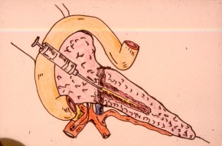
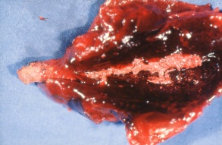
Wirsung’s occlusion with Cianoacrilate (Glubran 2®)

Slide 19
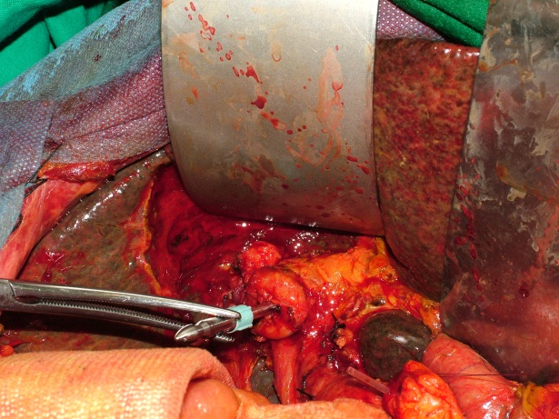
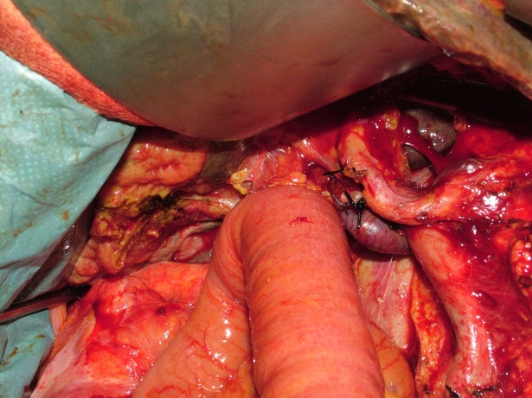
Biliodigestive Anastomosis

Slide 20
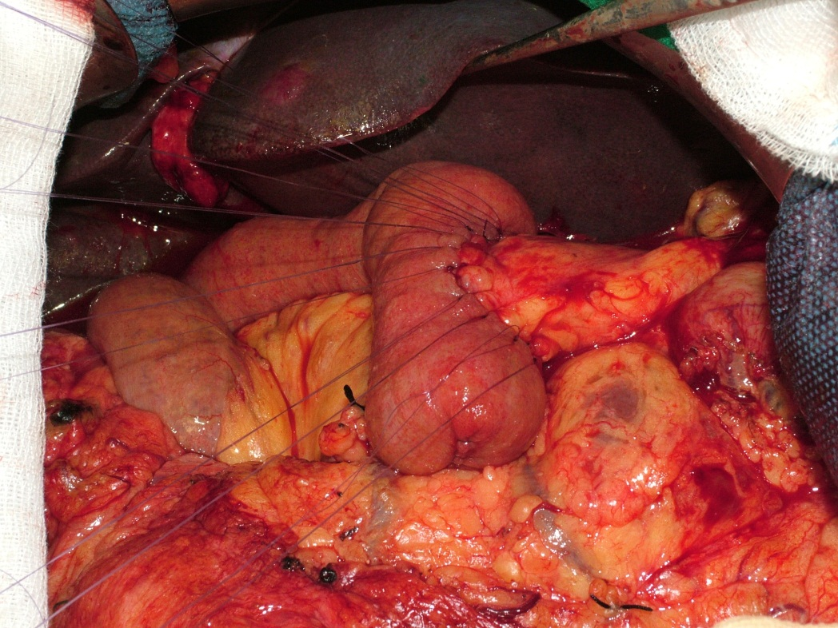
End to Side PJ anastomosis

Slide 21
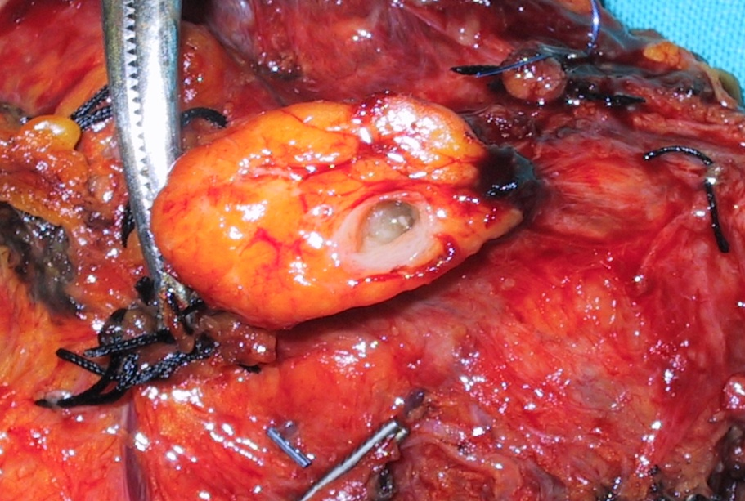
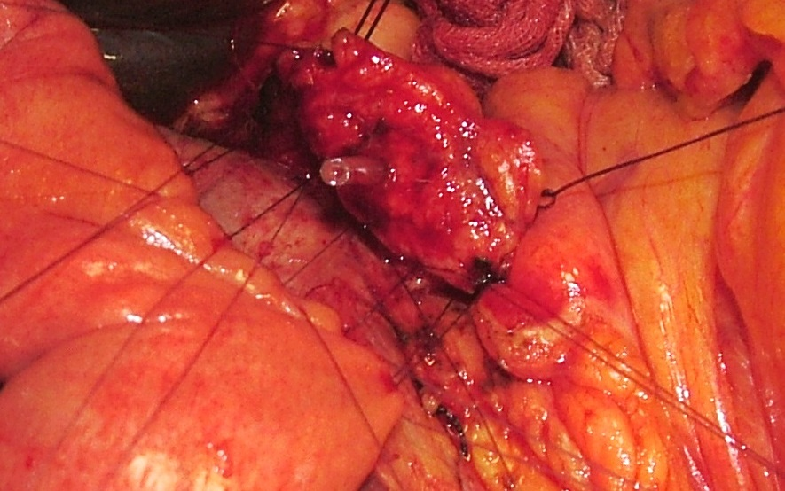
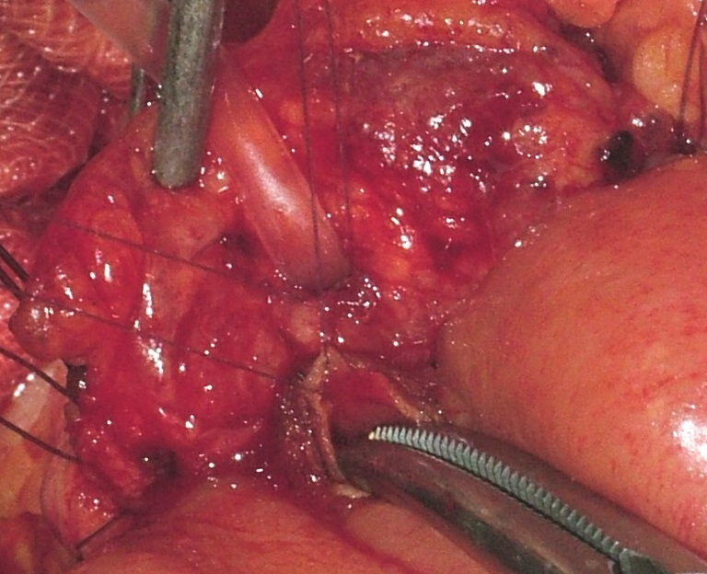
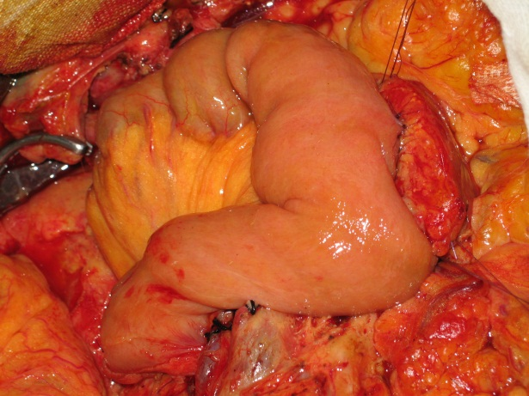
Duct to Mucosa PJ anastomosis

Slide 22
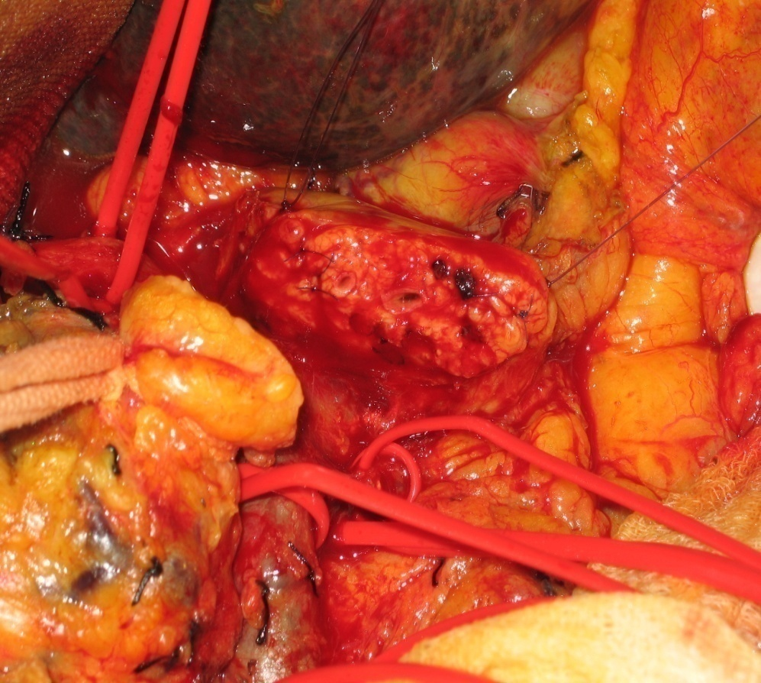
Double Major Pancreatic Duct

Slide 23
Management of Pancreatic Fistula
No clinical signs
Conservative management
Decreasing output
Improving condition
Worsening clinical signs
Re-Surgery
Delayed Haemorrhage
Emergency resuscitative measures
Endoscopy
Angiography
Failure to control bleed
Emergency Re-surgery
Increasing output
Worsening condition
Drains
Worsening clinical signs
Improving condition

Slide 24
Duodenopancreatectomy
Total 150
Classical Whipple 46
Pylorus Preserving 104
Management of Pancreatic Stump
Management | n° | Years
End to End PJ anastomosis | 32 | 2000-2003
End to Side PJ anastomosis | 44 | 2003-2007
Duct Occlusion | 33 | 2007-2010
Duct to Mucosa anastomosis | 41 | 2010-2012
Fistula %
15.6
13.6
50
0
A
B
C
D
Tersigni et al.

Slide 25
Postoperative Course, Complications and Outcome
Main Abdominal complications | A | B | C | D | Overall / %
Pancreatic Fistula | 4 | 6 | 15 | 0 | 25 (16,6)
Grade A | 2 | 4 | 11 | 0 | 17 (68)
Grade B | 1 | 2 | 3 | 0 | 6 (24)
Grade C | 1 | 0 | 1 | 0 | 2 (8)
Biliary Fistula | 0 | 0 | 0 | 0
Abscess | 2 | 0 | 0 | 0 | 2 (1,3)
Bleeding | 2 | 2 | 0 | 0 | 4 (2,6)
Acute pancreatitis | 0 | 1 | 0 | 0 | 1 (0,7)
Bowel Obstruction | 1 | 0 | 0 | 0 | 1 (0,7)
Other | 2 | 1 | 1 | 0 | 4 (2,6)
Post Op. Mortality | 5 | 3 | 1 | 0 | 9 (6,0)
Tersigni et al.

Slide 26
Periampullary and pancreatic neoplasms
Period | DCP | Mortality Pts. (%)
2000 – 2012 | 150 | 9 (6 %)
2005 - 2012 | 115 | 2 (1.75 %)
Tersigni et al.

Slide 27
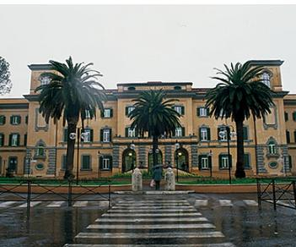
Grazie per l’attenzione

